Slide 1
Parking Spot System
S3-CB03 Group 3
Konstantin Hadjiyankov, Georgi Filev, Jaklin Yanakieva, Antonio Denkov, Kristian Hadzhikolev

Slide 2
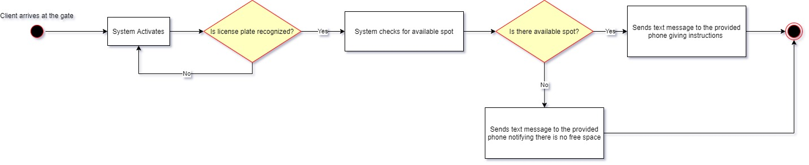
Logic Layer of the System

Slide 3
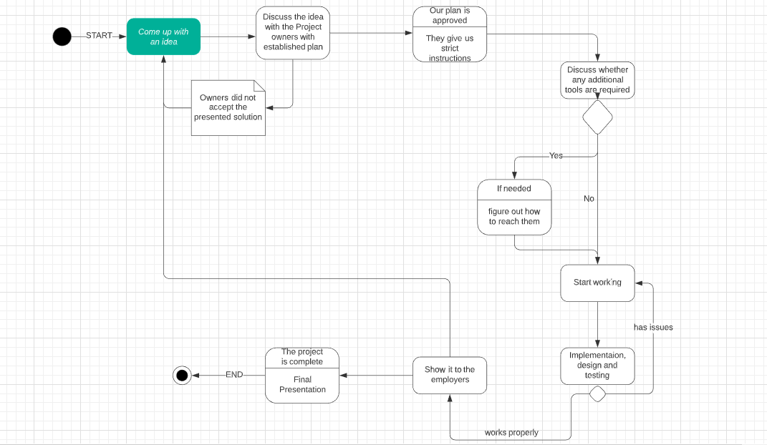
BPMN Diagram

Slide 4
What’s next?
Plan and divide the work
Create a wireframe
Create a GUI
Set up a database
Connect the database to the app
Architecture document
Research for a license plate recognition algorithm
Test the application
Test report
Update project plan from feedback

